Slide 1
DAMCO OCE Global Business Analysis
Business Analytics in Retail, marketing and demand forecasting

Slide 2
INDEX
Objective
Executive Summary and key findings
Data Summary and Preparation
POC, Modelling and Evaluation
Conclusion/Recommendation

Slide 3
Objective
Analyze trend and seasonality in DAMCO OCE Global business by studying monthly controlled export volume and forecast demand for year 2018 using advance time series forecasting techniques.

Slide 4
Executive Summary and key findings
DAMCO OCE Business Analysis

Slide 5
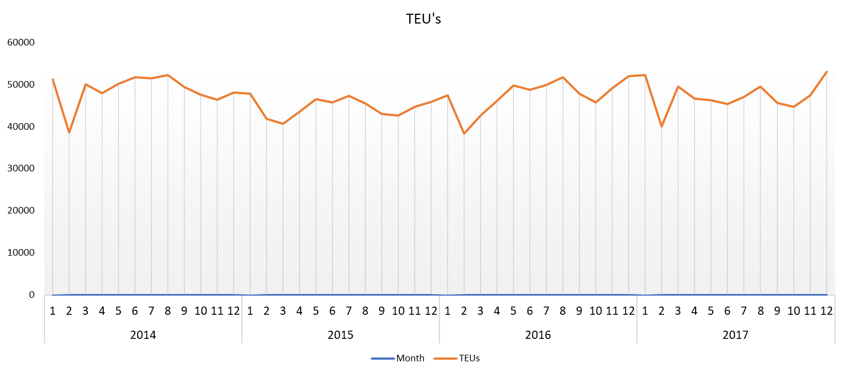
OCE Volume Jan 2014 till Dec 2017
Mostly flat with constant seasonality
Years total volume: 2.25m (TEUs)

Slide 6
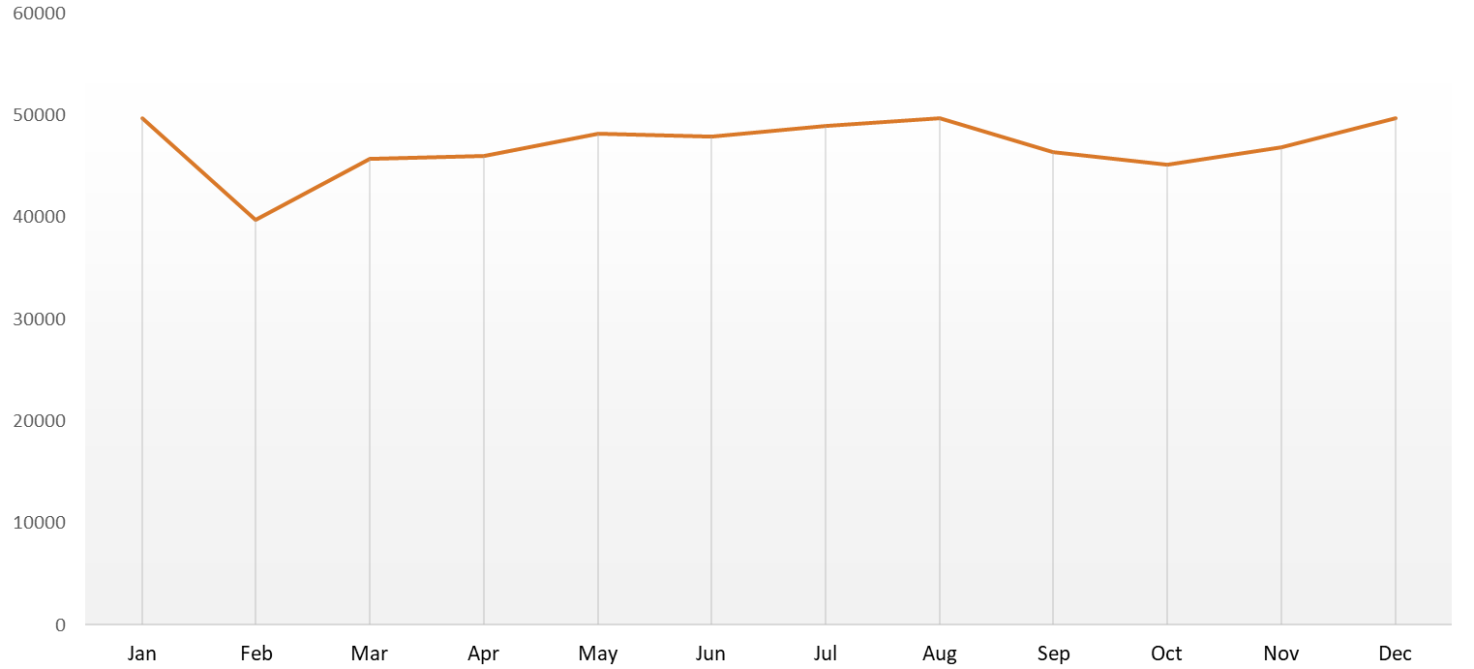
Month over Years analysis
~4% drop Golden week
‘CNY Effect’ ~15% drop in volume every Feb
Slight increasing trend in quarter 2 and 3
Avg. Monthly Volume : 46,983 (TEUs)

Slide 7
Executive Summary and key findings
Four-years data: Analysis is performed on four years volume data starting Jan 2014 to Dec 2017.
No Significant trend but constant seasonality visible- analyzing yearly/monthly level data- constant seasonal variation is prominent. Trend-wise, mostly flat except mild increase mid year.
On a typical year – two volume dips are observed – Feb and Oct.
Month of Year analysis suggests – In August we make more business compared to other months of year (on avg. 6% more OCE volume in August)
> ~15% drop in volume in month of Feb due to Chinese new year week
> Post CNY week we see increasing trend reaching peak during quarter 3.
> again, volume dips by ~4% in month of October due to Golden week.

Slide 8
Data Summary and Preparation
DAMCO OCE Business Analysis

Slide 9
Data Summary and Preparation
We have used year 2014 to 2017 Damco controlled monthly export OCE volume for our analysis. (Downloaded from onestream)
# Creating Development and Holdout Sample
> Development(Train): All monthly volume records in year 2014 to 2016
> Holdout(Test): All monthly volume records in year 2017

Slide 10
Lets Build Forecasting Model
DAMCO OCE Business Analysis

Slide 11
POC and Model selection
Using R we built 3 different time series models to forecast OCE volume
Triple exponential Holt-winter (ETS)
Auto ARIMA
Tuned ARIMA

Slide 12
Comparing 3 models based on Mean Absolute Percentage Error (MAPE):
Volume | Forecast 2017 |  |  | MAPE Calculation
Actual 2017 | Triple HW | Auto ARIMA | ARIMA | Triple HW | Auto ARIMA | Arima
52272.89 | 48329.33 | 50061.28 | 49597.52 | 0.075441795 | 0.045761253 | 0.053441916
40013.17 | 39312.46 | 43850.73 | 42389.04 | 0.017511918 | 0.097616957 | 0.054180916
49519.25 | 44159.28 | 45900.61 | 43076.75 | 0.108240122 | 0.081945168 | 0.140357603
46575.79 | 45500.48 | 48198.37 | 46192.01 | 0.023087291 | 0.035660749 | 0.007962485
46266.64 | 48356.37 | 50759.94 | 49612.47 | 0.045167142 | 0.092920577 | 0.06591481
45341.64 | 48378.28 | 49610.56 | 48355.39 | 0.066972477 | 0.088240462 | 0.060748192
46955.71 | 49215.20 | 50227.03 | 49621.76 | 0.04811963 | 0.066469735 | 0.053080011
49504.44 | 49496.10 | 51289.17 | 49527.25 | 0.000168541 | 0.036057921 | 0.000444665
45587.70 | 46436.24 | 48427.08 | 46361.64 | 0.018613405 | 0.061145827 | 0.015981602
44631.67 | 45039.84 | 46430.99 | 44396.7 | 0.009145336 | 0.039949556 | 0.005060594
47457.43 | 46351.28 | 47917.35 | 46795.75 | 0.023308251 | 0.009922494 | 0.013808771
53018.07 | 48302.42 | 50111.98 | 48654.97 | 0.088944245 | 0.06016453 | 0.087067053
 |  |  |  | 0.043726679 | 0.059654602 | 0.046504051

Slide 13
Final Model
Triple Exponential Holt-winter

Slide 14
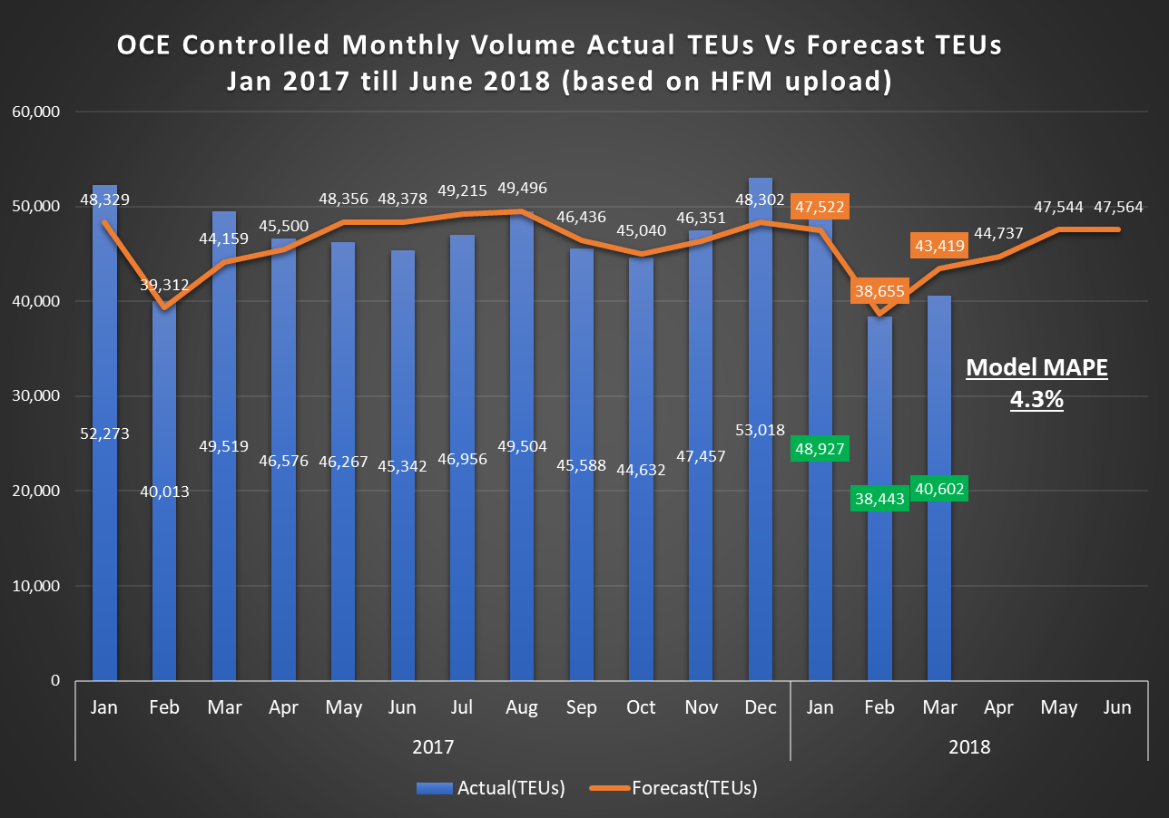
Year | Month | Actual(TEUs) | Forecast(TEUs)
2017 | Jan | 52,273 | 48,329
2017 | Feb | 40,013 | 39,312
2017 | Mar | 49,519 | 44,159
2017 | Apr | 46,576 | 45,500
2017 | May | 46,267 | 48,356
2017 | Jun | 45,342 | 48,378
2017 | Jul | 46,956 | 49,215
2017 | Aug | 49,504 | 49,496
2017 | Sep | 45,588 | 46,436
2017 | Oct | 44,632 | 45,040
2017 | Nov | 47,457 | 46,351
2017 | Dec | 53,018 | 48,302
2018 | Jan | 48,927 | 47,522
2018 | Feb | 38,443 | 38,655
2018 | Mar | 40,602 | 43,419
2018 | Apr |  | 44,737
2018 | May |  | 47,544
2018 | Jun |  | 47,564

Slide 15
Conclusion and Recommendations
Business is mostly flat throughout 2014 to 2017 with slight increasing trend– which is alarming.
There are two seasonal dips which cannot be avoided – knowing fact we should manipulate volume during rest period with marketing analytics.
We should try and exploit options to earn back lost volume around CNY and Golden week with following promotions during quite periods–
Complimentary services like- free pickup/drop/storage,
Early bird discounts,
Relaxation on Credit limits,
Buy NOW Pay later etc.
Further, drill down to customer level or week level volume data can help understand more latent insights.

Slide 16
Thank You

